Slide 1

Shri B.V.V. Sangha’s BASAVESHWAR ENGINEERING COLLEGE (AUTONOMOUS), BAGALKOT-587102
2018-2019
DEPARTMENT OF ELECTRONICS AND COMMUNICATION ENGINEERING
A PROJECT REPORT ON
“OPEN SOURCE BASED SELF DRIVING CAR”
PROJECT GUIDE HOD
Dr. B G SHEEPARAMATTI Dr. P N KULKARNI
PROJECT ASSOCIATES
USN
1) Mr. RUTWIK R PATIL 2BA15EC065
2) Mr. SAGAR PAWAR 2BA15EC068
3) Mr. BASAVARAJ S S 2BA16EC405
4) Mr. SANTOSH ROTTI 2BA15EC075

Slide 2
CONTENTS
Introduction
Objectives
Theoretical background
Proposed Work
Results and Conclusion

Slide 3
INTRODUCTION
An autonomous vehicle is a system capable of sensing its environment and navigate without the need of human action.
It includes various sensors like LIDAR, radar, camera inertial sensors and GPS.
The car will have to take logical decisions for the real life based on its map of the zone and the obstacles it detects, while following the fastest of the possible paths that will lead it to its desired destination.
Self-driving cars might become a cheaper and better, representing a shift on the way cities are planned.
In a smart city with most of its vehicles being connected and autonomous, trafﬁc optimization

Slide 4
OBJECTIVES
To build a self-driving car based on IoT and RF using entirely open source software (OpenCV, TensorFlow, Python) and hardware (Arduino) technology.
To reduce the cost of system, use CNN (Convolution Neural Network) for learning and control and also provide virtual remote control of car by human if necessary.
To use a single camera as input for navigation and obstacle avoidance.

Slide 5
THEORITICAL BACKGROUND
Software Components
Python programming language
OpenCV
TensorFlow
NVIDIA CUDA
Convolution Neural Network(CNN)

Slide 6
THEORITICAL BACKGROUND contd.
Additional Software Functions
pySerial
NumPy
Houghline Transform
Canny Edge detection
Gaussian Blur
TensorFlow Object detection API
AlexNet CNN

Slide 7
THEORITICAL BACKGROUND contd.
Hardware Components
Arduino
NRF24L01
DC Motors
Relay Module
Server Computer

Slide 8
PROPOSED WORK
The work is carried out in two steps
In the first part Houghline Transform is used to find the lanes and send steering commands accordingly
Second part discusses the use of a Convolution Neural Network (CNN) AlexNet to train a model and use it to make steering predictions.

Slide 9
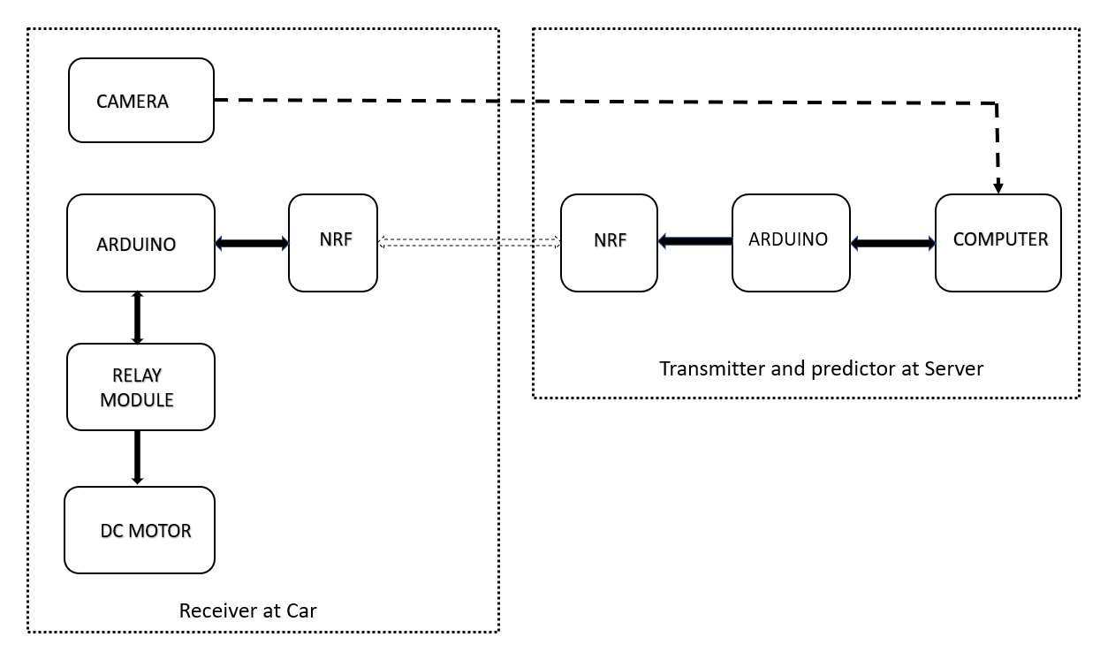
BLOCK DIAGRAM OF SETUP

Slide 10
Part 1 Lane Detection and Steering

Slide 11
1.1 Lane detection using Houghline Transform
Capture the image form Stream
Convert it to Grayscale
Canny Edge Detection
Apply 5x5 Gaussian Blur
Crop out Region Of Interest
Lane detection by HoughLine Transform
Calculate and output the slope of lanes
Flow Chart for Lane Detection Algorithm

Slide 12
1.2 Send Drive Command to Arduino via Serial Interface
Obtain Lane Slope data from HoughLine Transform
If m1<0 and m2<0
Send Right Turn command to Arduino
If m1>0 and m2>0
else
Send Left Turn command to Arduino
Send Go Straight command to Arduino

Slide 13
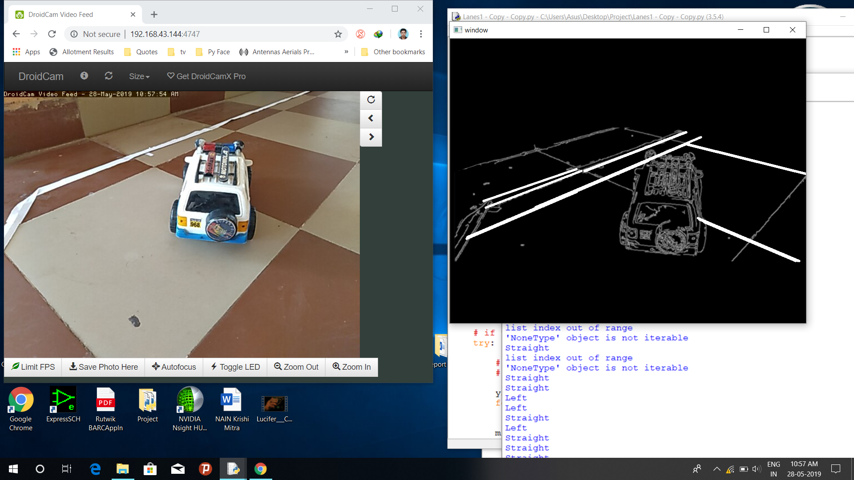
Screenshot of Lane detection and sending drive command to Arduino

Slide 14
1.3 Implementation of the TensorFlow Object Detection
Imports the object detection module utils
Load the frozen graph of Tensorflow model into memory
Loading label map indices to category name for prediction
Draw boxes, classify and visualize the results of detection
Calculate approx. distance
Capture the incoming Stream
Object detection using Tensorflow on GPU

Slide 15
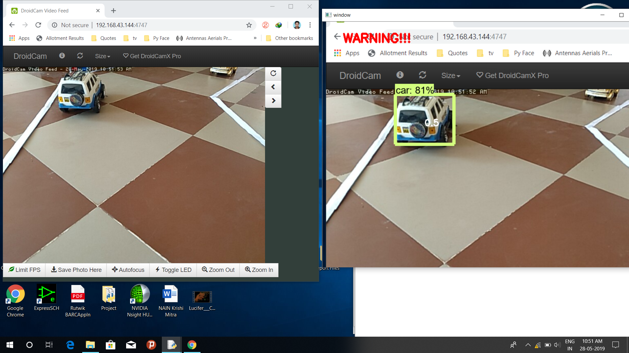
Screenshot of Object detection in action

Slide 16
Part 2 Training a Neural Network to make driving predictions

Slide 17
2.1 Algorithm for collecting the data
Convert to Greyscale and resize image
Log the control keys and corresponding image
Append keys and image data to a .npy file
Grab the stream

Slide 18
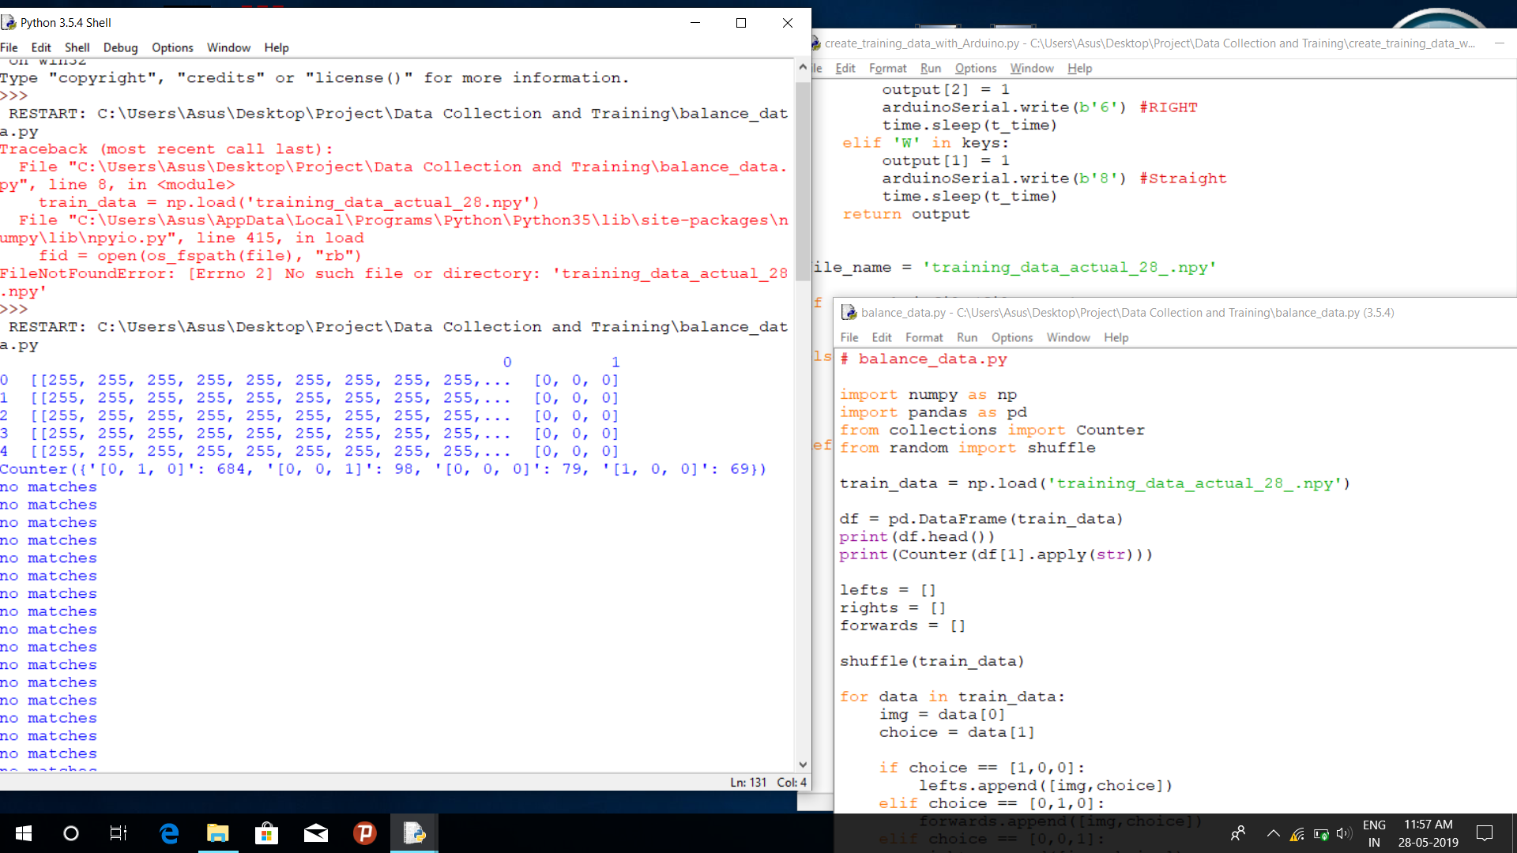
Screenshot of acquired data and balancing it

Slide 19
2.2 Training dataset using TensorFlow AlexNet on GPU
Set the Width, Height, Learning rate
Import the balanced Training dataset created
Set train and test values
Send parameters to AlexNet DCNN
train the model for specified epochs and save it

Slide 20
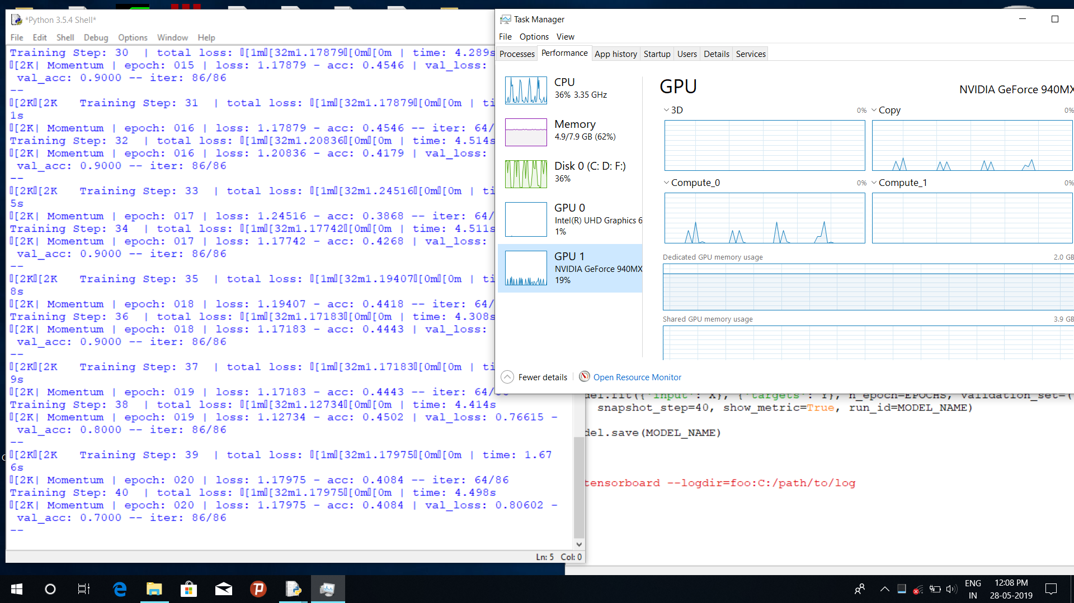
Screenshot of the model in training

Slide 21
2.3 Flowchart for using trained model to drive the car
Grab the Stream, convert to grayscale and resize
Load the trained Model and ALexNet DCNN with parameters specified
Apply the prediction model
Send Drive commands to Arduino via Serial port

Slide 22
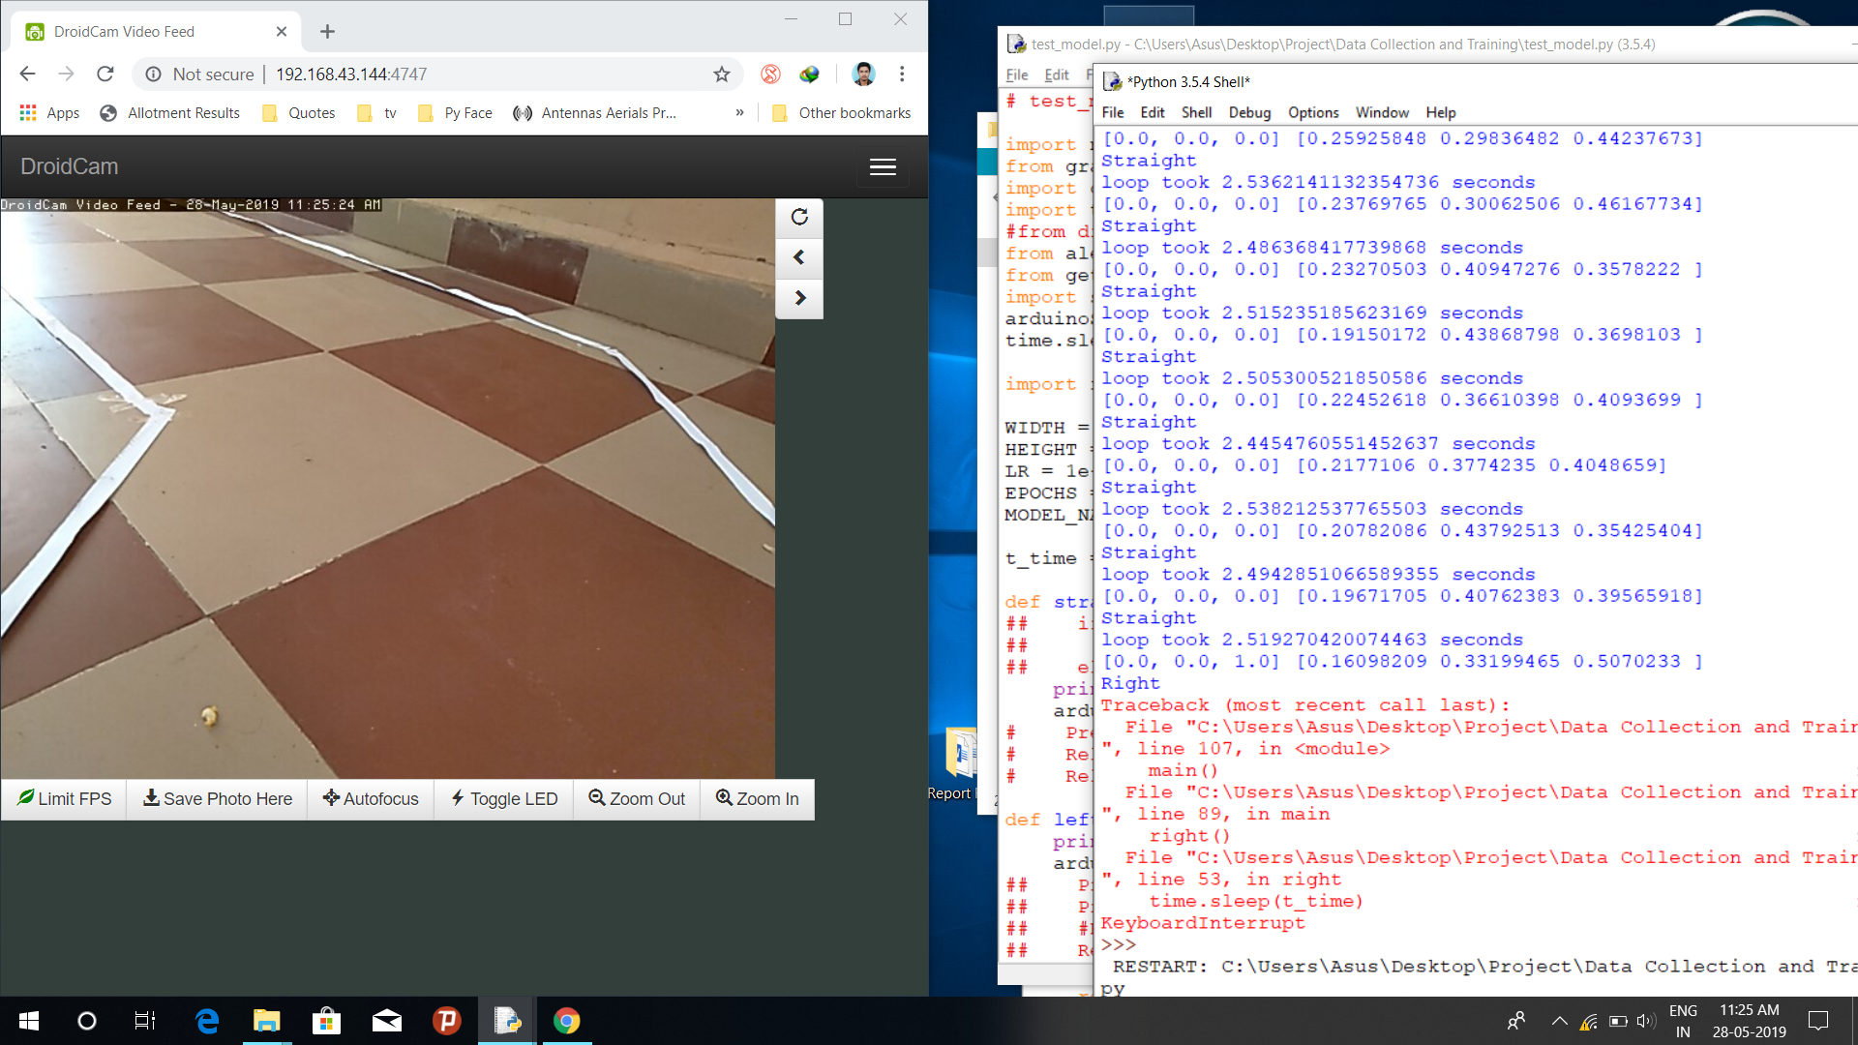
Screenshot of car in action

Slide 23
RESULTS AND CONCLUSIONS
In this project, a self-driving car based on IoT and RF is successfully built. This uses entirely open source software (OpenCV, TensorFlow, Python) and hardware (Arduino) technology.
By using open source technologies, cost of the system has been reduced.
Successfully used the CNN (Convolution Neural Network) for learning and controlling of car is done and virtual remote control by human is provided if necessary.
Single camera is used for both navigation and obstacle avoidance.

